Slide 1
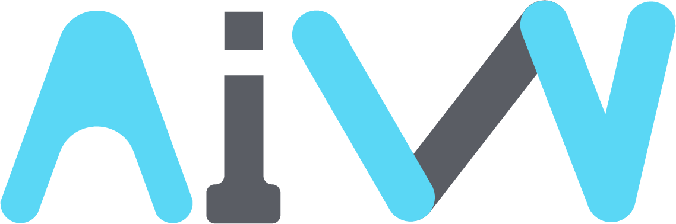

Utilizing blockchain and DAO
AI PLATFORM investment management
A.I RICCO LABS
Analysis and management with AI to ensure honest profit distribution solutions
A.I RICCO LABS | AIW Company profile

Slide 2
A.I RICCO LABS Overview
The AIW coin from A.I RICCO LABS leverages blockchain and DAO to transparently manage the M&A process, serving as a bridge for public participation.
BACKGROUND
VISION
We solve the problems of the M&A market through M&A coins using blockchain technology.
Promote the participation of investors and provide prompt services to those who need investment
It provides an expanded range of information disclosure, a stronger incentive structure for intermediaries, the introduction of its own M&A exchange, and a transparent decision-making process through DAOs. This will promote public participation in the M&A process and support various M&As for listed and unlisted companies to promote market generalization.
AIW Coin provides opportunities for the public to easily participate in tokenizing (STO) assets such as stocks, bonds, artworks, and real estate, starting with M&A of listed and unlisted companies. It also provides various benefits that allow you to participate more in decision-making based on the amount of AIW Coin you hold, influence the policies of the target company, and be involved in the decision-making of subsequent asset transactions.
Transparency in AI RICCO LABS
AI RICOO
LABS
Twice a year
MARKET
Semiannual financial report
Business Report

Slide 3
RICCO A.I. Business model
A.I RICCO LABS seeks to diversify and manage risk and distribute honest profits through various investments.
Investment strategy
stock investment
Mezzanine investment
Real estate investment
stock investment
Ratio
A. Investing in blue-chip stocks of listed companies around the world
Equity Investment : 30%
Invest in stocks with high dividend payout ratios and stable earnings
Altria Group
3M
Orange SA
A
50%
B. Investment in technology and growth industries
AI industry, new bio-tech, new energy technologies, and renewable energy
Global X China Energy
Total Energies
30%
B
20%
C. Investment using AI programs
Form a stable portfolio and target companies with low price or buy signals among the stocks in the portfolio using an AI program.
C
30%
52-week low
egative event for a company
war
Stock
Mezzanine
Real estate

Slide 4
RICCO A.I. Business model
A.I RICCO LABS seeks to diversify and manage risk and honestly distribute returns through a variety of investments.
Investment strategy
stock investment
Mezzanine investment
Real estate investment
Mezzanine investment
Ratio
A. Project-type investments for large enterprises and technologically advanced SMEs
Mezzanine Investment : 60%
Mezzanine investment : Generate fixed returns by securing equity in new businesses through mezzanine loans to large companies and technology-savvy start-ups
60%
Investment conditions : Pledge majority shareholder equity, include some level of equity conversion option, participate in business rights and patents, etc.
A
70%
Large international companies
Tech-based startups
B. Convertible Bond(CB) or Bond with Warrant(BW)
High growth
High growth potential
Small businesses
Small businesses
B
30%
Pre-IPO
Innovative Technology
Stock
Mezzanine
Real estate
Startups
Startups

Slide 5
RICCO A.I. Business model
A.I RICCO LABS seeks to diversify and manage risk and honestly distribute returns through a variety of investments.
Investment strategy
stock investment
Mezzanine investment
Real Estate Investment
Real Estate Investment
Ratio
A. Commercial Real Estate
Real Estate Investment : 10%
Investing in prime urban office buildings and commercial spaces
New York
Singapore
London
Tokyo
B. Residential Real Estate
A
70%
Investing in luxury residential properties for steady rental income.
San Francisco
Sydney
Paris
C. Development Projects
10%
Investing in emerging markets for capital gains.
B
20%
India
Vietnam
Brazil
C
10%
Stocks
Mezzanine
Real estate

Slide 6
RICCO A.I. Business model
A.I RICCO LABSseeks to diversify investments, manage risks, and ensure fair profit distribution.
Regional Portfolio Composition
Risk Management and Hedging Strategy
Investment Profit Settlement
“Regional Portfolio Composition”
"Investment strategies prepared for various scenarios."
"Investment returns for investors participating in projects."
United States
Diversified Investments
Equity Investment
Technology stocks, real estate development projects, mid-sized innovative companies
Risk management through investments across various regions and industries
Capital gains from stock sales + dividend income
Europe
Mezzanine Investment
Renewable energy projects, healthcare companies, commercial real estate
Capital gains from stock sales + interest earnings
Selective Investments
Differentiating investment size and conditions based on potential risks and capital recovery feasibility
Asia (Excluding Korea)
Real Estate Investment
Growth stocks and startup investments in emerging markets (India, Vietnam, etc.)
Rental income from real estate + capital gains from property sales
Other Regions
Derivatives
Promising real estate and infrastructure projects in South America and Africa
Risk management using options, futures, and other derivatives
Evaluated and settled through dividends (or investment profit distribution)

Slide 7
Role of the RICCO A.I. Platform
A.I RICCO LABS establishes global asset management firms and AI research labs, utilizing AI for investment assessments, local partnerships, and implementing a fair evaluation system to refine detailed strategies..
Establishment of Local Teams & Expert Recruitment
Establishing Investment Processes
Establishing Partnerships
Performance Monitoring & Feedback
Establishment of overseas asset management firms and AI research labs
Market research and industry-specific analysis for each region
Collaboration with local investment firms
Establishment of a system for regular investment performance evaluation
Recruitment of stock market experts
Investment and development projects with real estate developers
Development of AI-driven risk models
Comprehensive analysis of investment returns, risks, and cash flow
Recruitment of real estate specialists
Collaboration with local startup incubators
Multi-stage investment screening: Initial, mid-stage, and final evaluation for thorough verification
Monthly and quarterly investment performance reviews
Recruitment of mezzanine investment experts
AI program development and investment in AI companies worldwide

Slide 8




A.I RICOO DAO PLATFORM
Utilizing the A.I RICOO DAO PLATFORM, investors can easily access and engage in stable investment activities.
Platform Growth
Platform Operation Structure
1 STEP
A.I RICOO LABS independent investment
2 STEP
Platform
AIW
Individual
Co-investment between A.I RICOO LABS and small-scale investors (users)
3 STEP
Autonomous investment by institutions and small-scale investors
AIW
Voting power
Investment Recovery
AIW
4 STEP
Investment requests from various sellers, including listed companies
A.I RICOO LABS
When CB (Convertible Bonds) and BW (Bond Warrants) issuance, as well as third-party allotment for listed companies, are successfully completed, NFTs will be generated.
5 STEP
Project
Exchange
Sellers, institutional investors, and small-scale investors freely utilize the platform

Slide 9

A.I RICOO DAO PLATFORM
Utilizing the A.I RICOO DAO PLATFORM, investors can easily access and engage in stable investment activities.
At the time of investment recovery for each project, the AIW token and the stock price of the invested listed company fluctuate compared to the initial investment period.
Investors who hold NFTs from participating projects can compare the profits and losses of stock investments and AIW tokens, choosing the more favorable option to maximize returns and minimize losses.
If A.I RICOO LABS and small-scale investors (users) participate in a third-party allocation capital increase, and the stock price falls below 75% of the assigned price, the NFT will be reclaimed from small investors, and the previously invested AIW tokens will be refunded.

Slide 10
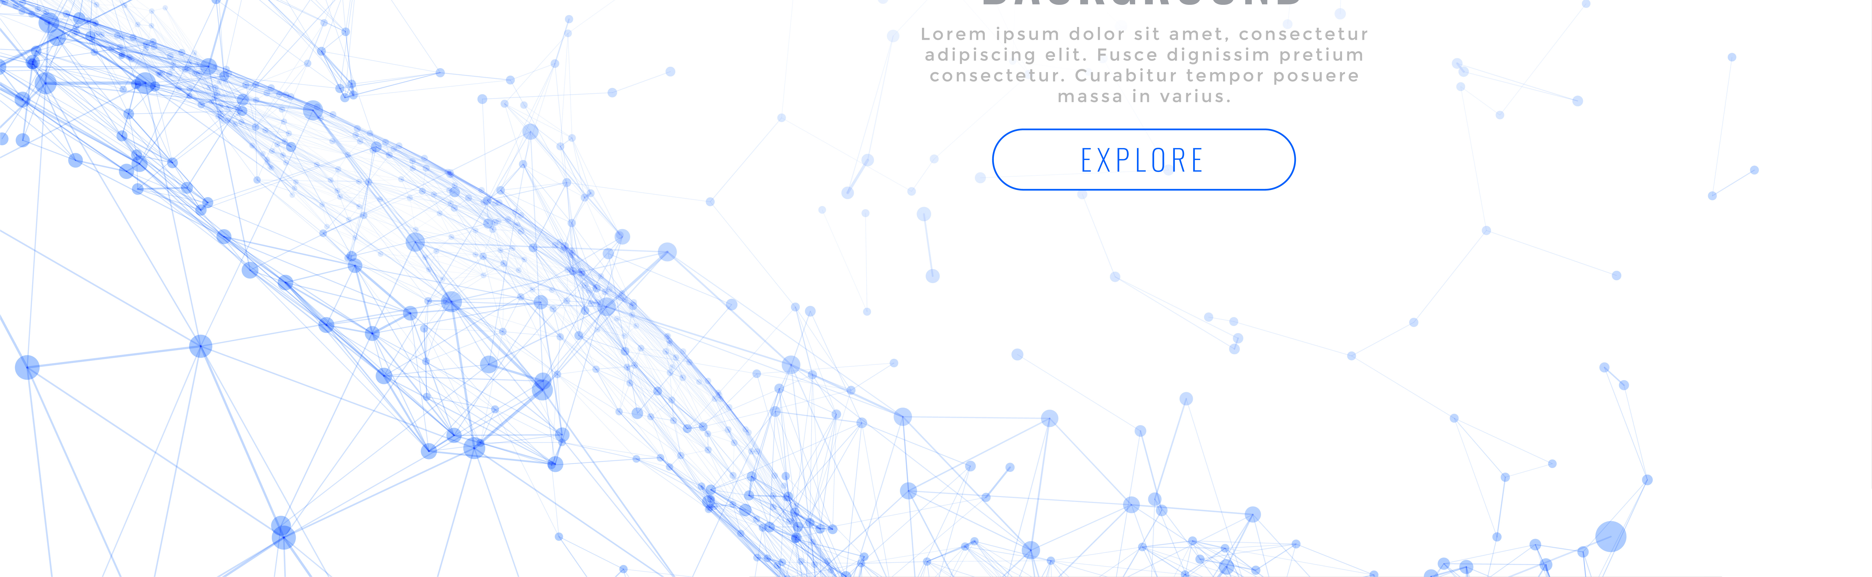
SOLUTION - AIW Token Usage and Application Solutions
SOLUTION AIW tokens can be used in various ways, and customized solutions are structured to increase profitability while managing and diversifying risks.
.
01
Earned by Holding AIW Tokens Voting Power
AIW
AIW
AIW
AIW
AIW
AIW
AIW
The amount of AIW tokens held determines the MAX Voting Power value, and maintaining it for 24 hours grants 1/10 of MAX (Mandatory 10-day Lock).
24h
MAX Voting Power value
Mandatory 10-day Lock
02
03
04
Participation by Users Community
Using Voting Power Investment Participation
INVEST Results
Real-time information and communication help investors make informed decisions and provide essential details for AIW token investments.
Voting Power is used depending on the project, and AIW tokens are utilized for real investment, issuing an NFT certificate afterward.
After investment results are disclosed, NFTs are converted into AIW upon project liquidation, and in dividend projects, AIW is distributed as dividends on the payout date (Dividend Lock applies).
NFT
Stock Information
NFT Certificate Issuance
AIW
AIW
AIW
Dividends
Company Information
Investor
AIW
AIW
AIW
Investor
InvestorA
InvestorB

Slide 11
AIW Token Usage and Application Solutions
SOLUTION AIW tokens can be used in various ways, and customized solutions are structured to increase profitability while managing and diversifying risks.
05
06
07
for Project Participation Perpetual NFT Loan
for Trading NFT Collateral Loan
NFT Index Investment (Second Milestone)
NFT certificates can be used as collateral to borrow 50% of AIW tokens at an annual interest rate of 12%. If the value drops to 75% of the principal and interest, it is automatically liquidated. 30% of the interest is allocated as a DAO platform fee.
NFTs can be used as collateral to borrow up to 200% of the NFT value in AIW tokens at an annual interest rate of 12%.
If the collateral ratio drops below 130%, automatic liquidation occurs, while withdrawals and transfers are allowed when the ratio exceeds 180% (requires a certain amount of Voting Power upon application).
NFTs obtained from the A.I RICOO DAO platform can be traded like stock indices, with transactions being publicly available via user voting or A.I RICOO LABS governance.
Spot and margin trading are available, similar to stock markets (including unlisted stocks).
AIW
AIW
50% AIW Loan
NFT
NFT
200% NFT Loan
Stock Information
AIW
AIW
12% Annual Interest
Investor
Stock Information
Company Information
Company Information
12% Annual Interest
Investor

Slide 12
SOLUTION - AIW Token Usage and Application Solutions
SOLUTION AIW tokens can be used in various ways, and customized solutions are structured to increase profitability while managing and diversifying risks.
08
09
10
NFT Marketplace
AIW Token Staking Strategy
Token Value Enhancement
Users can sell NFTs in the DAO marketplace using ETH, USDT, and AIW.
Fixed price, auction sales, and stock index information display are available, including unlisted stock NFTs.
A.I RICOO DAO PLATFORM plans to launch staking products ranging from 1 to 12 months, with a cap of 200 million tokens.
Dividend yield is set at 10%, varying based on the staking period (announced annually on May 20 and November 20).
5-15% of project revenue is used to repurchase and burn AIW tokens on the exchange.
20% of net income from financial statements is also used for buyback and burn.
When a project is created, AIW serves as a payment currency, leading to an automatic burn effect.
ETH
USDT
A.I RICOO DAO PLATFORM
Project
5-15% Buy
Financial
Statement
20% Buy
Project
AIW Burn
AIW
Dividend Rate 10%

Slide 13
SOLUTION - AIW Token Usage and Application Solutions
SOLUTION AIW tokens can be used in various ways, and customized solutions are structured to increase profitability while managing and diversifying risks.
11
Coin Value Enhancement Policy
AIW Token Sale
1.
A portion of revenue generated through projects is burned
AIW
AIW
AIW
AIW
KRW
USDT
2.
20% of the company's net income is repurchased and burned in the market
3.
Burn effect occurs when a project is created
AIW tokens can be sold for various currencies such as KRW and USDT.
Additional Opinions
4.
Attracting professional stock traders
The price of AIW tokens is expected to fluctuate based on the value of invested companies and A.I RICOO DAO LABS' investment portfolio.
5.
Expecting increased demand for coins through Voting Power strategy in corporate investments
6.
Using coins as a payment method for platform-provided information and services
7.
Encouraging increased coin demand through diverse investment portfolios
8.
Ensuring investment liquidity by developing financial products based on coin value conversion and listing on multiple international exchanges

Slide 14
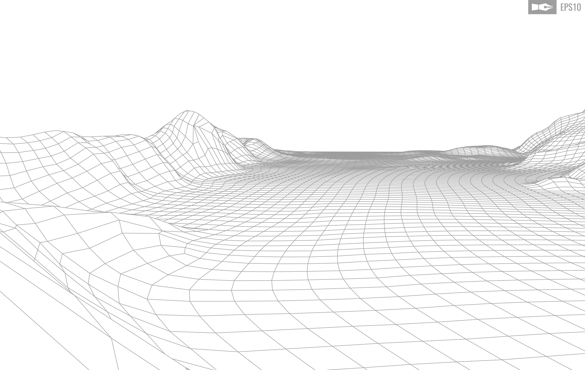

Detailed Organizational R&R
A.I RICOO collaborates with multiple companies to pursue active investment activities.
No | Company name | Role and Responsibility
1 | A.I RICCO DAO PLATFORM | AI development, big data business, and blockchain development for listed companies.
2 | A.I RICCO SOFT | IT company specializing in AI development, big data business, and blockchain development for listed companies.
3 | AIW M&A INVESTMENT | Direct/indirect investment operations, corporate analysis, tax/accounting management, and investor relations.
4 | A.I RICCO BRIDGE VENTURES | VC-listed company acquisitions, government policy funding, institutional investment fundraising, and fund structuring and operation.
5 | A.I RICCO CAPITAL | Secondary financial institution acquisitions, stock/coin/real estate collateral lending, and third-party loans.
6 | A.I RICCO ARTBLOCK | Acquisitions of entertainment companies, movie companies, and auction houses. Development of an art auction platform, and investments in fine arts, music, and film production.

Slide 15
OUR MEMBERS
Name | Position | Major Career Experience
Peter, KIM | CEO | INHA University, Master's degree in Business Administration from FUDAN University (Shanghai) Head of New Business Team at Arion Technology Investment Director at KIB Ventures Expert Advisor at the Korea Industry Intelligentization Association (KIIA)
Jayden, KIM | CIO | Degree in Law from Chung-Ang University (Seoul) Investment Director at KDB-Lonestar CRC General Manager at BCEX Korea Executive Director at UOD Group
Andrei Rusedi | CSO | University of Technology Sydney THE STAR Entertainment Group CSO (Australia)
Joshua Nelsen | CTO | University of Utah, Salt Lake City Dollar Tree networking manager, Holladay, UT (USA) Amazon networking manager, Salt Lake City, UT (USA)

Slide 16
OUR MEMBERS
Name | Position | Major Career Experience
Christina Lee Balsom | Consultant | The Evergreen State College, Olympia Material Inspector Associate (USA) Nacel Open Door foundation director (USA)
Dan Ngoc Diep | Consultant | Vietnam’s National Economics University DAKAO CFO (Vietnam)
Le Tiep | Consultant | The Hague University (Netherlands) Anchor equity partners financial manager (Vietnam)
Le Hong Thai | Consultant | Vietnam’s National Economics University Chairman of CDC Vietnam Investment Development & Technology JSC (Vietnam)

Slide 17
A.I RICCO LABS
THANK YOU

